Slide 1
Introduction to Circuits Analysis
by Andrew G. Bell
abell118@ivytech.edu
(260) 481-2288
Lecture 11

Slide 2
CHAPTER 11
Basic AC Quantities

Slide 3
AC and DC Differences
Alternating Current
Current: Magnitude and direction change periodically
Voltage: Magnitude and direction change periodically
Sine Wave: Most common representation

Slide 4
AC and DC Differences (cont.)
Direct Current
Current: Single magnitude and direction
Voltage: Single magnitude and direction

Slide 5
AC Power and Transmission
AC advantageous over DC in transmission of power over long distances
AC has ability to be stepped up or down
AC easily produced by generators

Slide 6
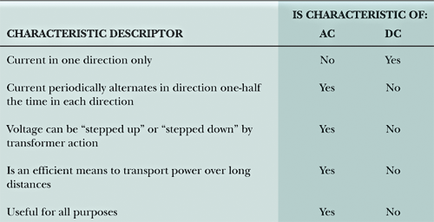
AC and DC Characteristics

Slide 7
Mathematical Concepts
360° angular motion
0° starting point
Angles increase in positive CCW direction
Maximum positive value at 90°
0 volts at 180°
Maximum negative value at 270°

Slide 8
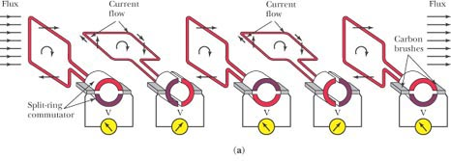
Generating AC Voltage
Voltage developed by wire moving in magnetic field

Slide 9
Radians and Degrees
Radians Degrees
0 0°
π/2 90°
π 180°
3π/2 270°
2π 360°

Slide 10
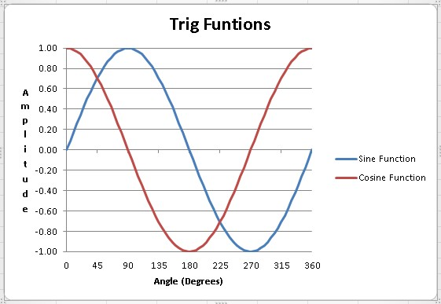
Use Excel create a plot of the Sine and Cosine functions
Remember, Excel uses radians not degrees so all angles must be converted to radians
Excel

Slide 11
Flux Lines and Induced Voltage
Zero volts at 0°,180°, and 360°
Maximum at 90° and 270°
Positive values between 0° and 180°
Negative values between 180° and 360°

Slide 12
Sine Wave Summary
Amplitude characteristics follow sine function.
Amplitude constantly varies in value.
Direction periodically reverses.

Slide 13
Sine Wave Terms
Cycle: 360°
Period (T): Time required to complete a cycle
Unit of Measure: Seconds (sec)
Frequency (f): Number of cycles in a second
Unit of Measure: Hertz (Hz)
Alternation: Half of a sine wave

Slide 14
Equations

Slide 15
Commercial Power
Period = 16.67 milliseconds
Frequency = 60 Hertz

Slide 16
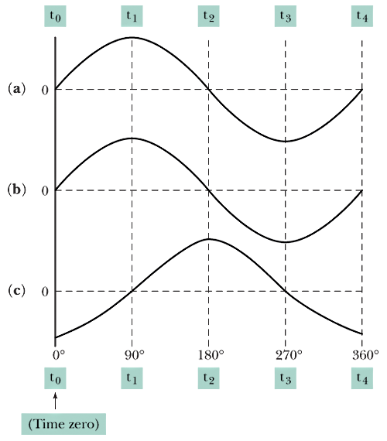
Phase Relationships

Slide 17
Phase Relationships (cont.)
In Phase: When two voltages or currents have the same frequency and pass through zero and reach their maximums at the same time
Out of Phase: When two voltages or currents are the same frequency but pass through zero and reach their maximums at different times

Slide 18
AC Measurements
Peak: I_{p} or V_{p}
Peak-to-Peak: 2 × V_{p}
Average: 0.637 × V_{p}
Effective: rms value, 0.707 × V_{p}
Instantaneous: v = V_{p} sin θ

Slide 19
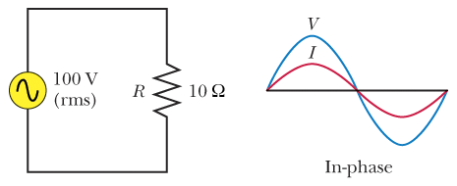
Purely Resistive Circuit

Slide 20
Other Periodic Waveforms
Square wave
Rectangular wave
Sawtooth wave

Slide 21
Parameters
Pulse Width: Time a waveform is positive-going
Period: Time between positive-going transitions
Duty Cycle: Pulse width divided by the period

